Slide 1

CatBreed
Display list of cat breeds
When a user clicks on a list item for a cat breed, the detail view for that breed should be shown
Project link - https://github.com/rajatshukla2910/CatBreed

Slide 2
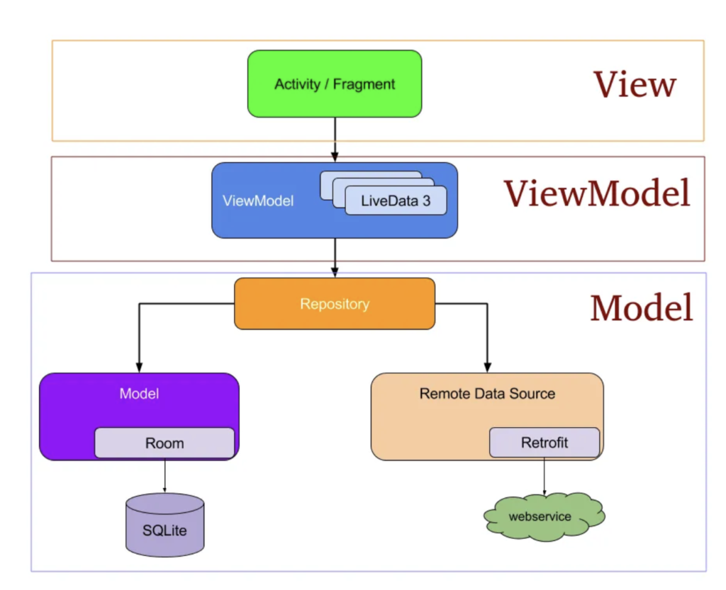
MVVM Architecture
Used MVVM (Model-View-ViewModel) architecture to help separate concerns, make the code more modular, testable, and easier to maintain.
CatBreedsFragment
BreedDetailFragment
CatBreedsViewModel
CatBreedsRepository
TheCatAPI

Slide 3

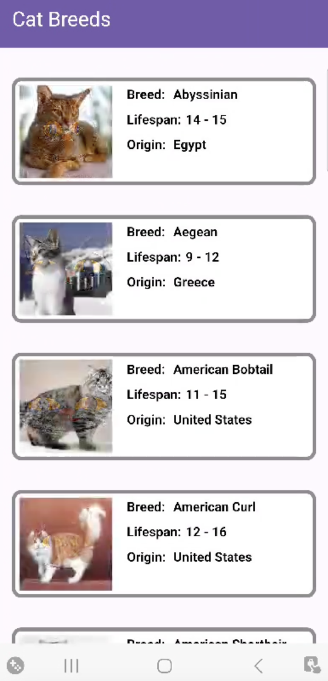
List of Cat breeds
The app calls TheCatAPI to retrieve a list of cat breeds, with each breed entry including the following details -
Unique identifier
Breed name
Description of the breed
Image of the breed
Lifespan
Origin

Slide 4
Pagination
Pagination in the CatBreed app ensures that the list of cat breeds is loaded in manageable chunks, improving performance and providing a smoother user experience.

Slide 5
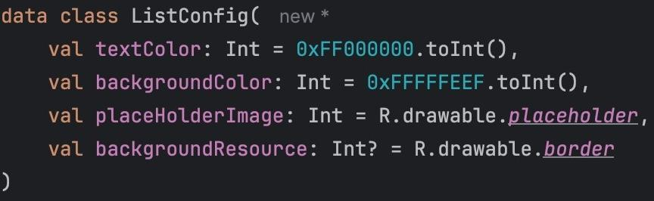
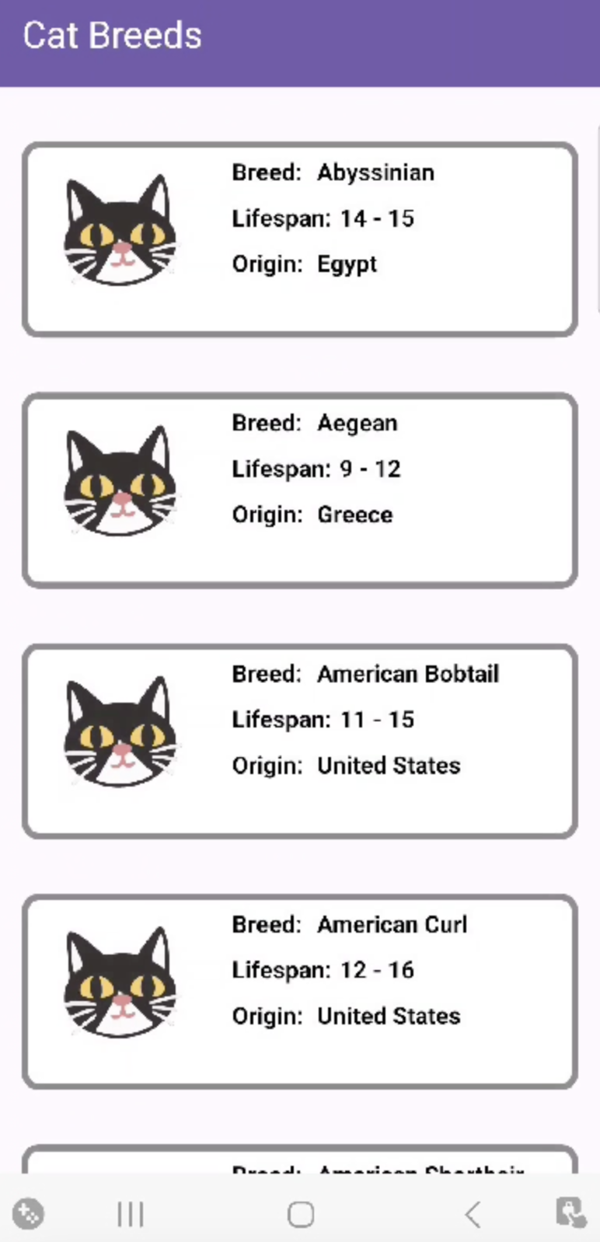
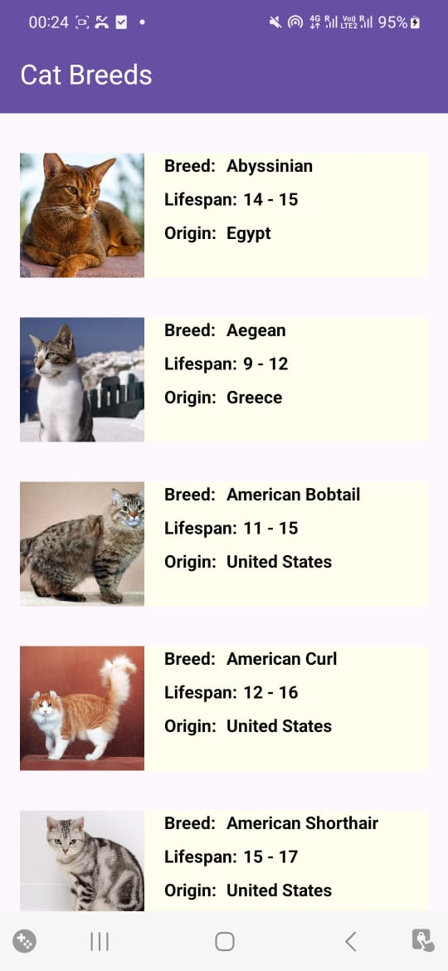
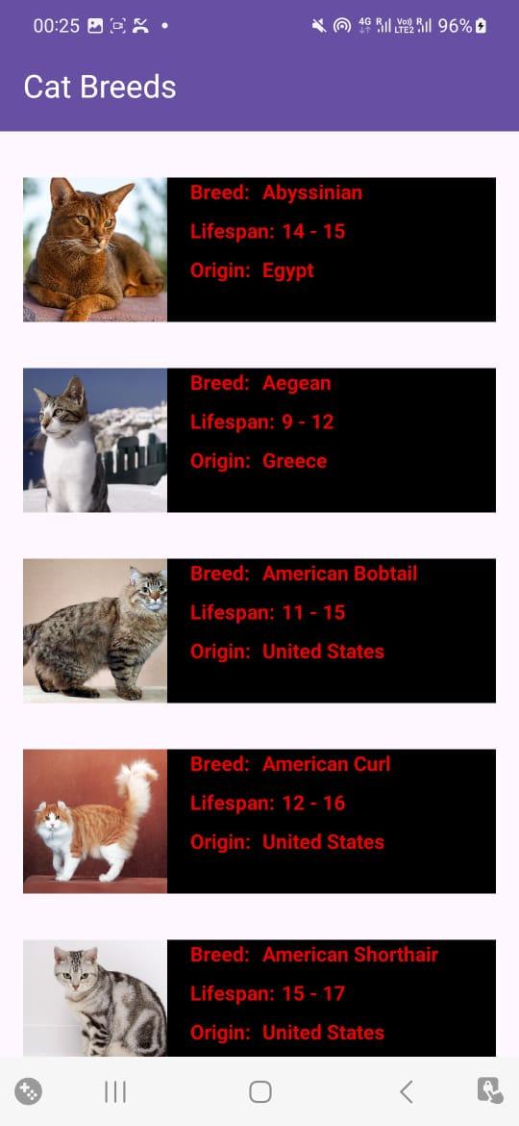
ListConfig
List configuration will help configure the cell as per the respective list requirement.
textColor: The color of the text for the cell
backgroundColor: The color of the cell background
placeHolderImage: The default image for the breed if API fails to fetch image
backgroundResource: The background image for the cell

Slide 6
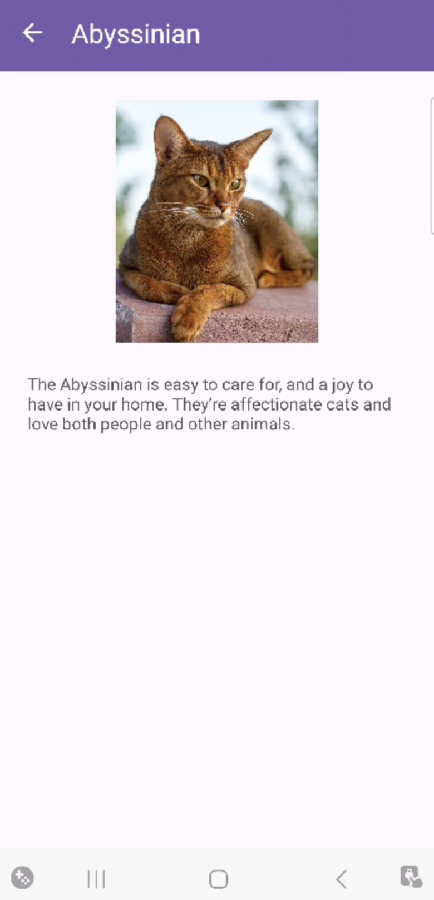
Detail view of Cat breeds
Tapping on any cat breed tile opens a detailed view displaying an image and comprehensive description of the selected breed received from TheCatAPI.
Title of the screen changes to the respective breed name of the cat.

Slide 7
Components used
Following components have been used to make this app -
Coroutine Coroutines are a way to manage asynchronous programming by allowing code to run on different threads without blocking the main thread, which is crucial for keeping an app responsive.
Flows Ideal for continuous or sequential data processing, making it a great fit for real-time data streams, data updates, and sequential API calls
Hilt Dependency injection (DI) library that simplifies and standardizes DI using Dagger under the hood.
JUnit Test JUnit is a popular unit testing framework for Java, used for testing functions, classes, and modules.

Slide 8
Improvement scope
Efficient Image Loading Cache images for faster loading experience and reduced data usage.
Cache Data Locally Store fetched data in a local database (like Room) to provide offline access, allowing users to view previously loaded breeds.
Accessibility & Localisation Add features like descriptive content for screen readers, color contrast adjustments and support multiple languages to make the app more user-friendly for non-English speakers.
Search & Filter options Allow users to search breeds by name or filter by characteristics like origin, lifespan, or size.
Matched Geometry Effect Matched geometry effect could be added for a smoother transition from breed cell to breed detail view.
Enhanced Breed Detail View The breed detail screen could be in a card form containing all other information relevant to the respective breed.

